Slide 1
B-Tree

Slide 2
INTRODUCTION
Binary Search tree contain one value and two pointers left and right
Which points to node s left and right sub tree
Same concept in M way search trees
Which has m-1 values per node and M sub trees
M is called degree of the Tree.

Slide 3
Introduction
In such a tree M is called the degree of the tree. Note in a binary search tree M = 2, so it has one value and 2 sub-trees. In other words, every internal node of an M-way search tree consists of pointers to M sub-trees and contains M – 1 keys, where M > 2.
P₀ | K₀ | P₁ | K₁ | P₂ | K₂ | ……… | P_{n-1} | K_{n-1} | P_{n}
In the structure, P0, P1, P2,…, Pn are pointers to the node’s sub-trees and K0, K1, K2,…, Kn-1 are the key values of the node. All the key values are stored in ascending order. That is, Ki < Ki+1 for 0 ≤ i ≤ n-2.
In an M-way search tree, it is not compulsory that every node has exactly (M-1) values and have exactly M sub-trees. Rather, the node can have anywhere from 1 to (M-1) values, and the number of sub-trees may vary from 0 (for a leaf node) to 1 + i, where i is the number of key values in the node. M is thus a fixed upper limit that defines how much key values can be stored in the node.

Slide 4
Introduction
 | 18 |  | 45
 | 9 |  | 11
 | 27 |  | 36
 | 54 |  | 63
 | 29 |  | 30
 | 72 |  | 81
In the structure, P0, P1, P2,…, Pn are pointers to the node’s sub-trees and K0, K1, K2,…, Kn-1 are the key values of the node. All the key values are stored in ascending order. That is, Ki < Ki+1 for 0 ≤ i ≤ n-2.
In an M-way search tree, it is not compulsory that every node has exactly (M-1) values and have exactly M sub-trees. Rather, the node can have anywhere from 1 to (M-1) values, and the number of sub-trees may vary from 0 (for a leaf node) to 1 + i, where i is the number of key values in the node. M is thus a fixed upper limit that defines how much key values can be stored in the node.

Slide 5
B-Trees
A B-tree is a specialized m- way tree that is widely used for disk access.
Used to index the Data in a Data base of very large size and provide fast Access.
B tree of order m can have maximum m-1 keys and m pointers to its sub-trees. A B-tree may contain a large number of key values and pointers to sub-trees. Storing a large number of keys in a single node keeps the height of the tree relatively small.
A B-tree is designed to store sorted data and allows search, insert, and delete operations to be performed in logarithmic amortized time. A B-tree of order m (the maximum number of children that each node can have) is a tree with all the properties of an m-way search tree and in addition has the following properties:
Every node in the B-tree has at most (maximum) m children.

Slide 6

B-Trees
Every node in the B-tree except the root node and leaf nodes have at least (minimum)[m⁄2 ]children. This condition helps to keep the tree bushy so that the path from the root node to the leaf is very short even in a tree that stores a lot of data.
The root node has at least two children if it is not a terminal (leaf) node.
All leaf nodes are at the same level.
An internal node in the B tree can have n number of children, where 0 ≤n ≤ m. it is not necessary that every node has the same number of children, but the only restriction is that the node should have at least m/2 children.

Slide 7
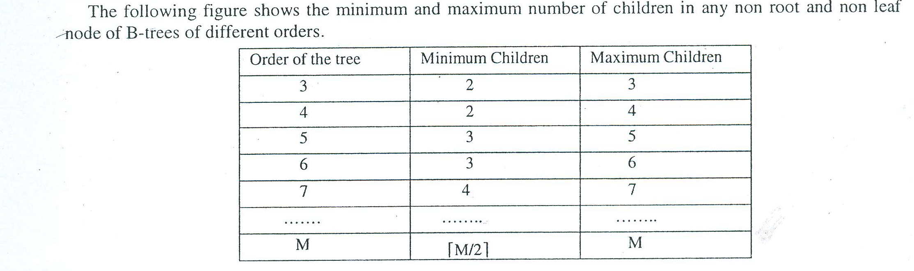

Slide 8
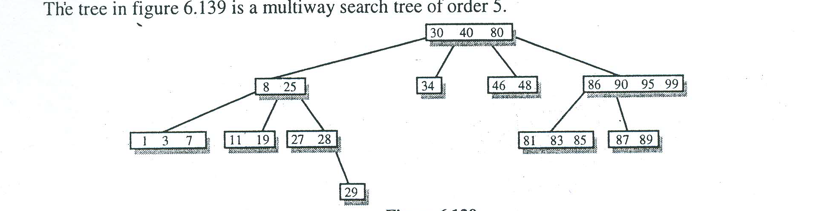

Slide 9
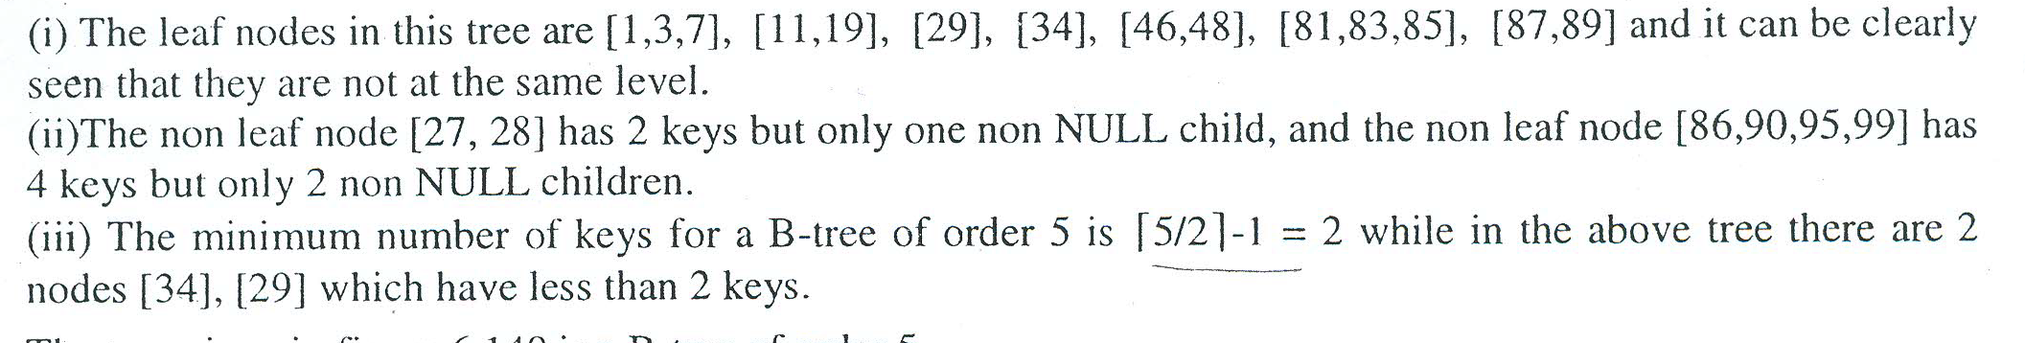

Slide 10
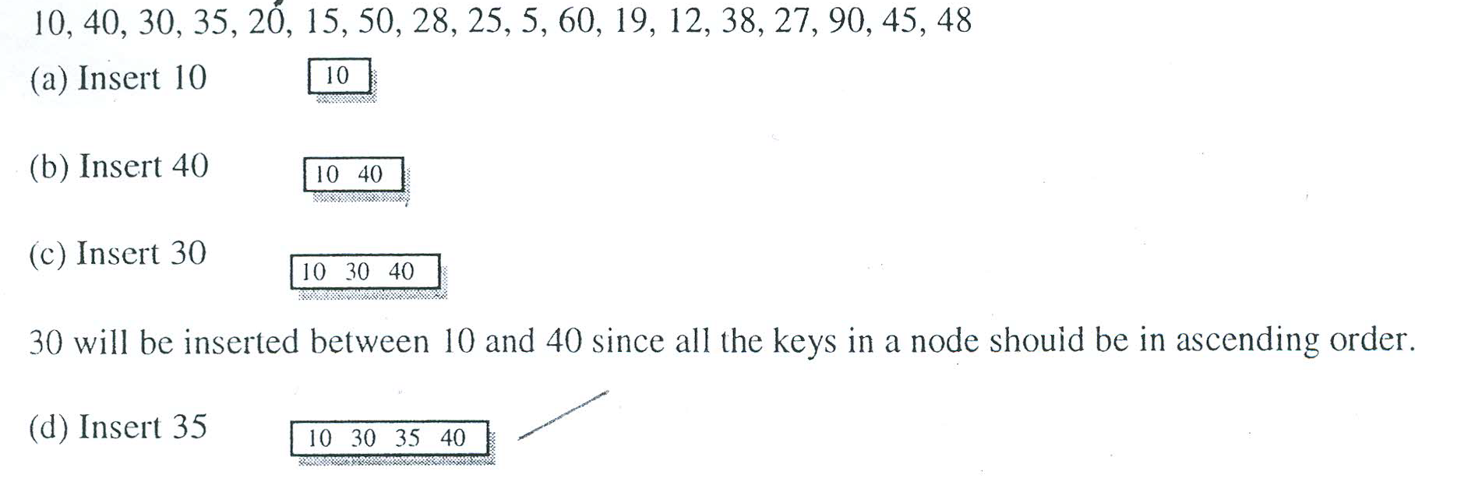
insertion

Slide 11
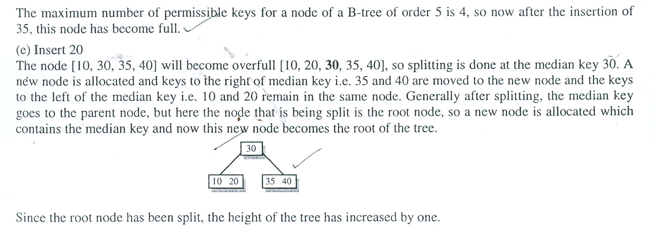

Slide 12
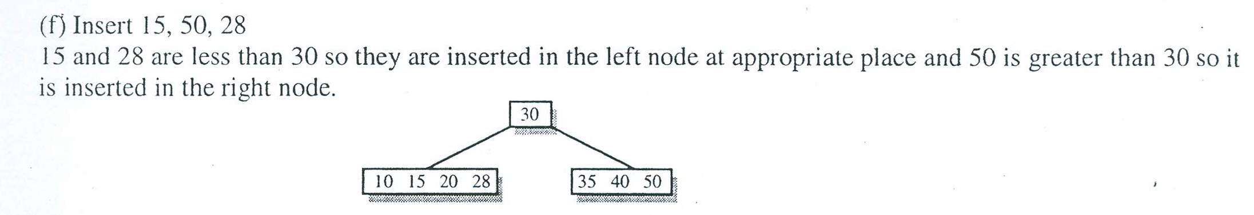

Slide 13
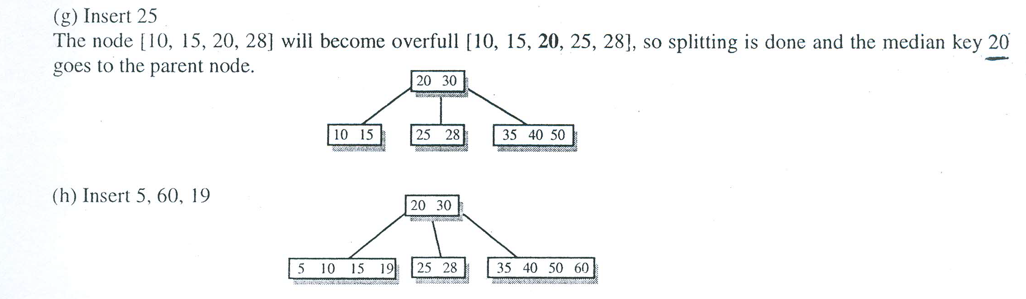

Slide 14
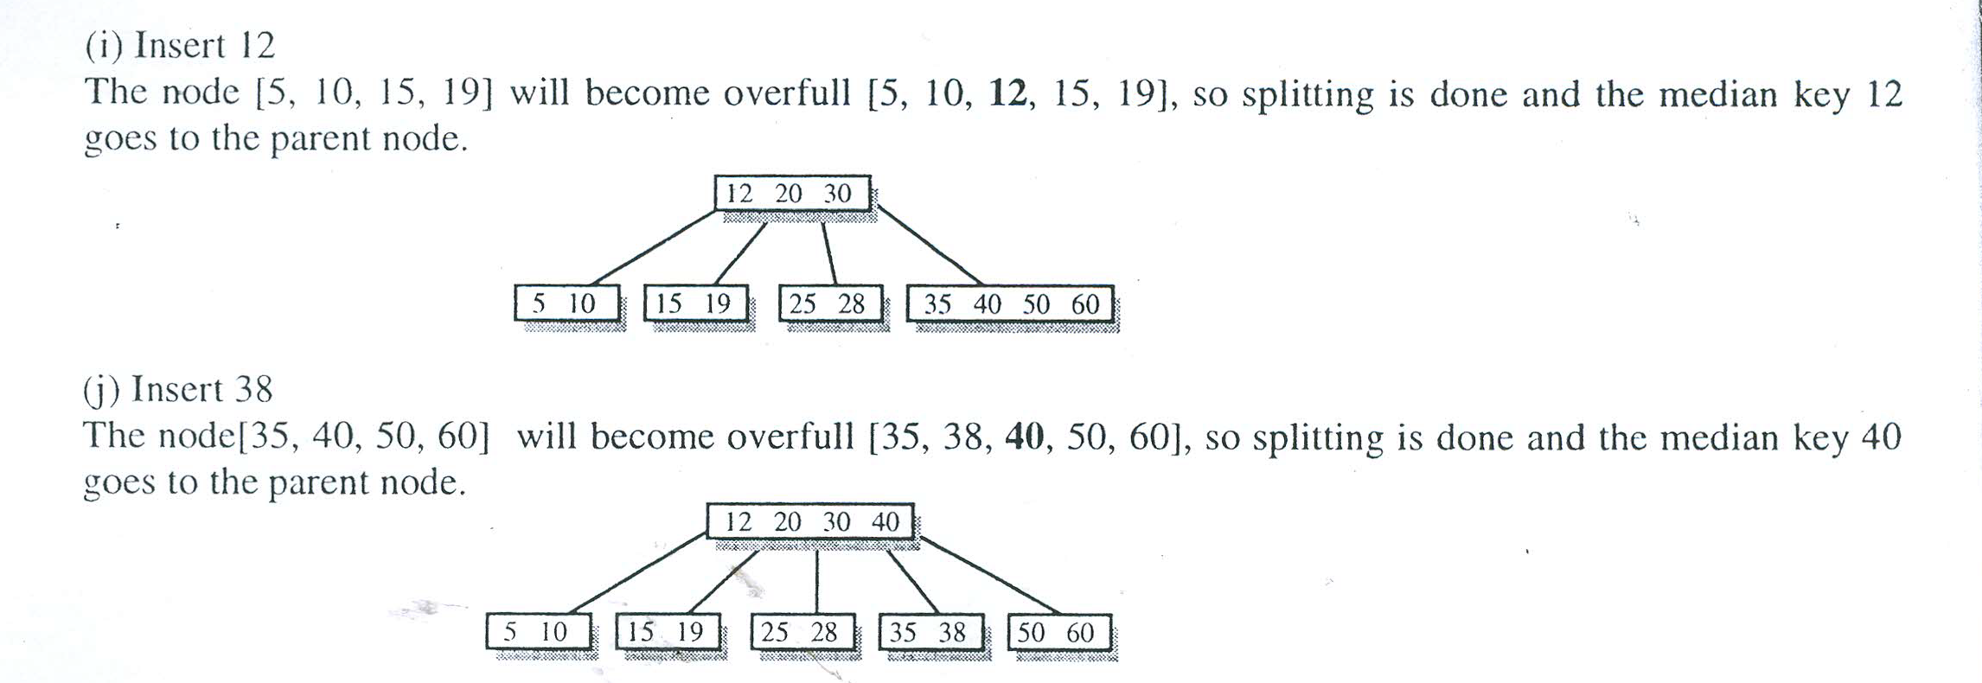

Slide 15
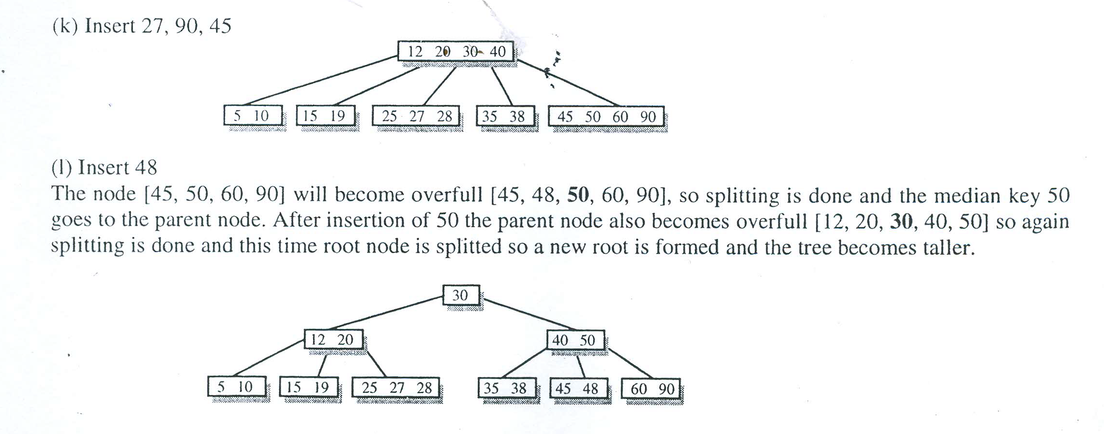

Slide 16
B-Trees
O | 45 | O
O | 29 | O | 32 | O
O | 49 | O | 63 | O
O | 54 | O | 59 | O | 61 | O
O | 30 | O | 31 | O
O | 67 | O | 72 | O
O | 36 | O | 39 | O
O | 46 | O | 47 | O
O | 18 | O | 27 | O

Slide 17
B-Trees
Insert Operation
In a B tree all insertions are done at the leaf node level. A new value is inserted in the B tree using the algorithm given below.
Search the B tree to find the leaf node where the new key value should be inserted.
If the leaf node is not full, that is it contains less than m-1 key values then insert the new element in the node, keeping the node's elements ordered.
If the leaf node is full, that is the leaf node already contain m-1 key values then
insert the new value in order into the existing set of keys split the node at its median into two nodes. note that the split nodes are half full. Push the median element up to its parent’s node. If the parent’s node is already full, then split the parent node by following the same steps.

Slide 18
B-Trees
Example: Look at the B tree of order 5 given below and insert 8, 9, 39 into it.
O | 18 | O | 45 | O | 72 | O
O | 7 | O | 11 | O
O | 54 | O | 63 | O
O | 21 | O | 27 | O | 36 | O | 42 | O
O | 81 | O | 89 | O | 90 | O
O | 18 | O | 45 | O | 72 | O
O | 7 | O | 8 | O | 11 | O
O | 21 | O | 27 | O | 36 | O | 42 | O
O | 54 | O | 63 | O
O | 81 | O | 89 | O | 90 | O
O | 18 | O | 45 | O | 72 | O
O | 81 | O | 89 | O | 90 | O
O | 7 | O | 8 | O | 9 | O | 11 | O
O | 21 | O | 27 | O | 36 | O | 42 | O
O | 54 | O | 63 | O
O | 18 | O | 36 | O | 45 | O | 72 | O
O | 81 | O | 89 | O | 90 | O
O | 7 | O | 8 | O | 9 | O | 11 | O
O | 21 | O | 27 | O
O | 39 | O | 42 | O
O | 54 | O | 63 | O

Slide 19
Deletion
Like insertion, deletion is also done from the leaf nodes. There are two cases of deletion. First, a leaf node has to be deleted. Second, an internal node has to be deleted. Let us first see the steps involved in deleting a leaf node.
Locate the leaf node which has to be deleted
If the leaf node contains more than minimum number of key values (more than m/2 elements), then delete the value.
Else, if the leaf node does not contain even m/2 elements then, fill the node by taking an element either from the left or from the right sibling
If the left sibling has more than the minimum number of key values (elements), push its largest key into its parent’s node and pull down the intervening element from the parent node to the leaf node where the key is deleted. Else if the right sibling has more than the minimum number of key values (elements), push its smallest key into its parent node and pull down the intervening element from the parent node to the leaf node where the key is deleted.

Slide 20
Deletion
Else, if both left and right siblings contain only minimum number of elements, then create a new leaf node by combining the two leaf nodes and the intervening element of the parent node (ensuring that the number of elements do not exceed the maximum number of elements a node can have, that is, m). If pulling the intervening element from the parent node leaves it with less than minimum number of keys in the node, then propagate the process upwards thereby reducing the height of the B tree.
To delete an internal node, promote the successor or predecessor of the key to be deleted to occupy the position of the deleted key. This predecessor or successor will always be in the leaf node. So further the processing will be done as if a value from the leaf node has been deleted.

Slide 21
Deletion in a B tree can be classified in two cases
Deletion from leaf node
Deletion from non leaf node

Slide 22
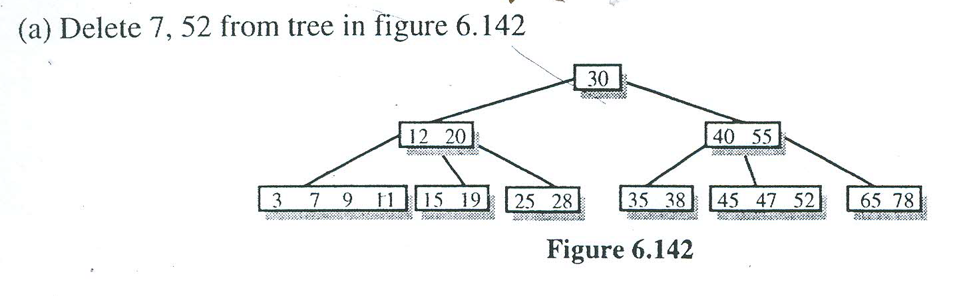

Slide 23
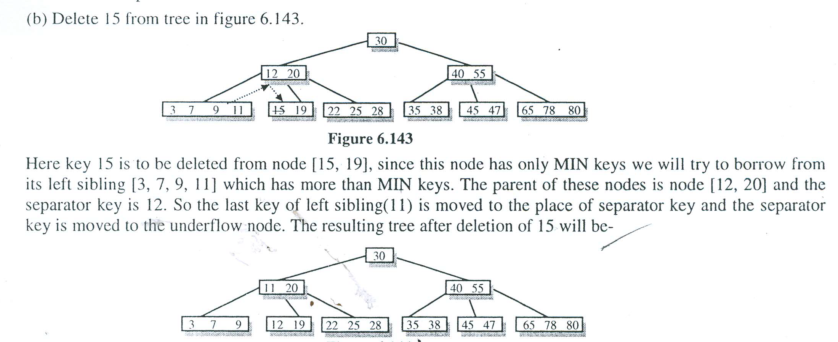
IF NODe has MIN Keys

Slide 24


Slide 25


Slide 26
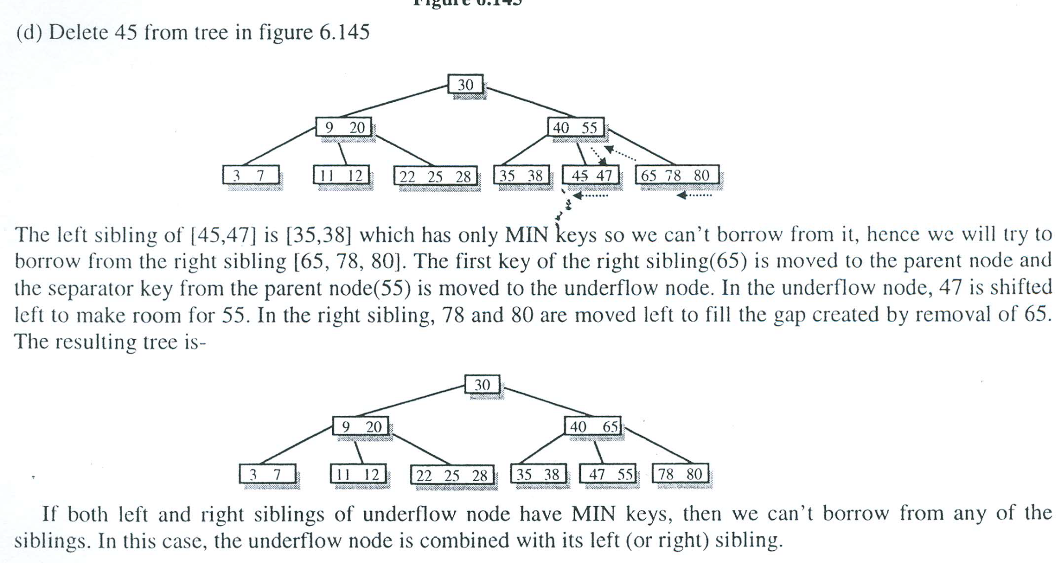

Slide 27
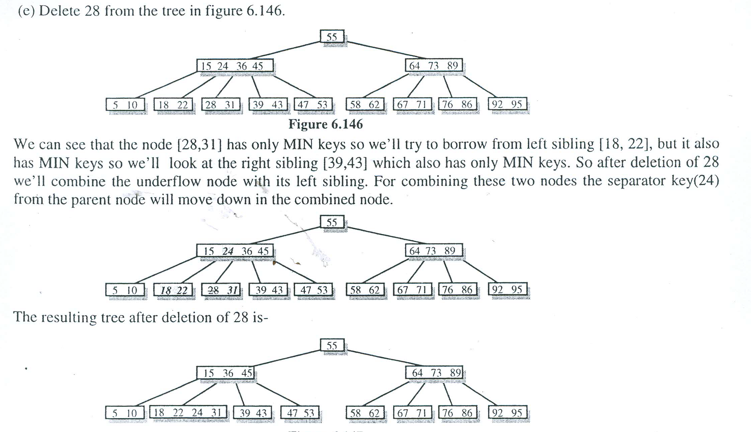

Slide 28
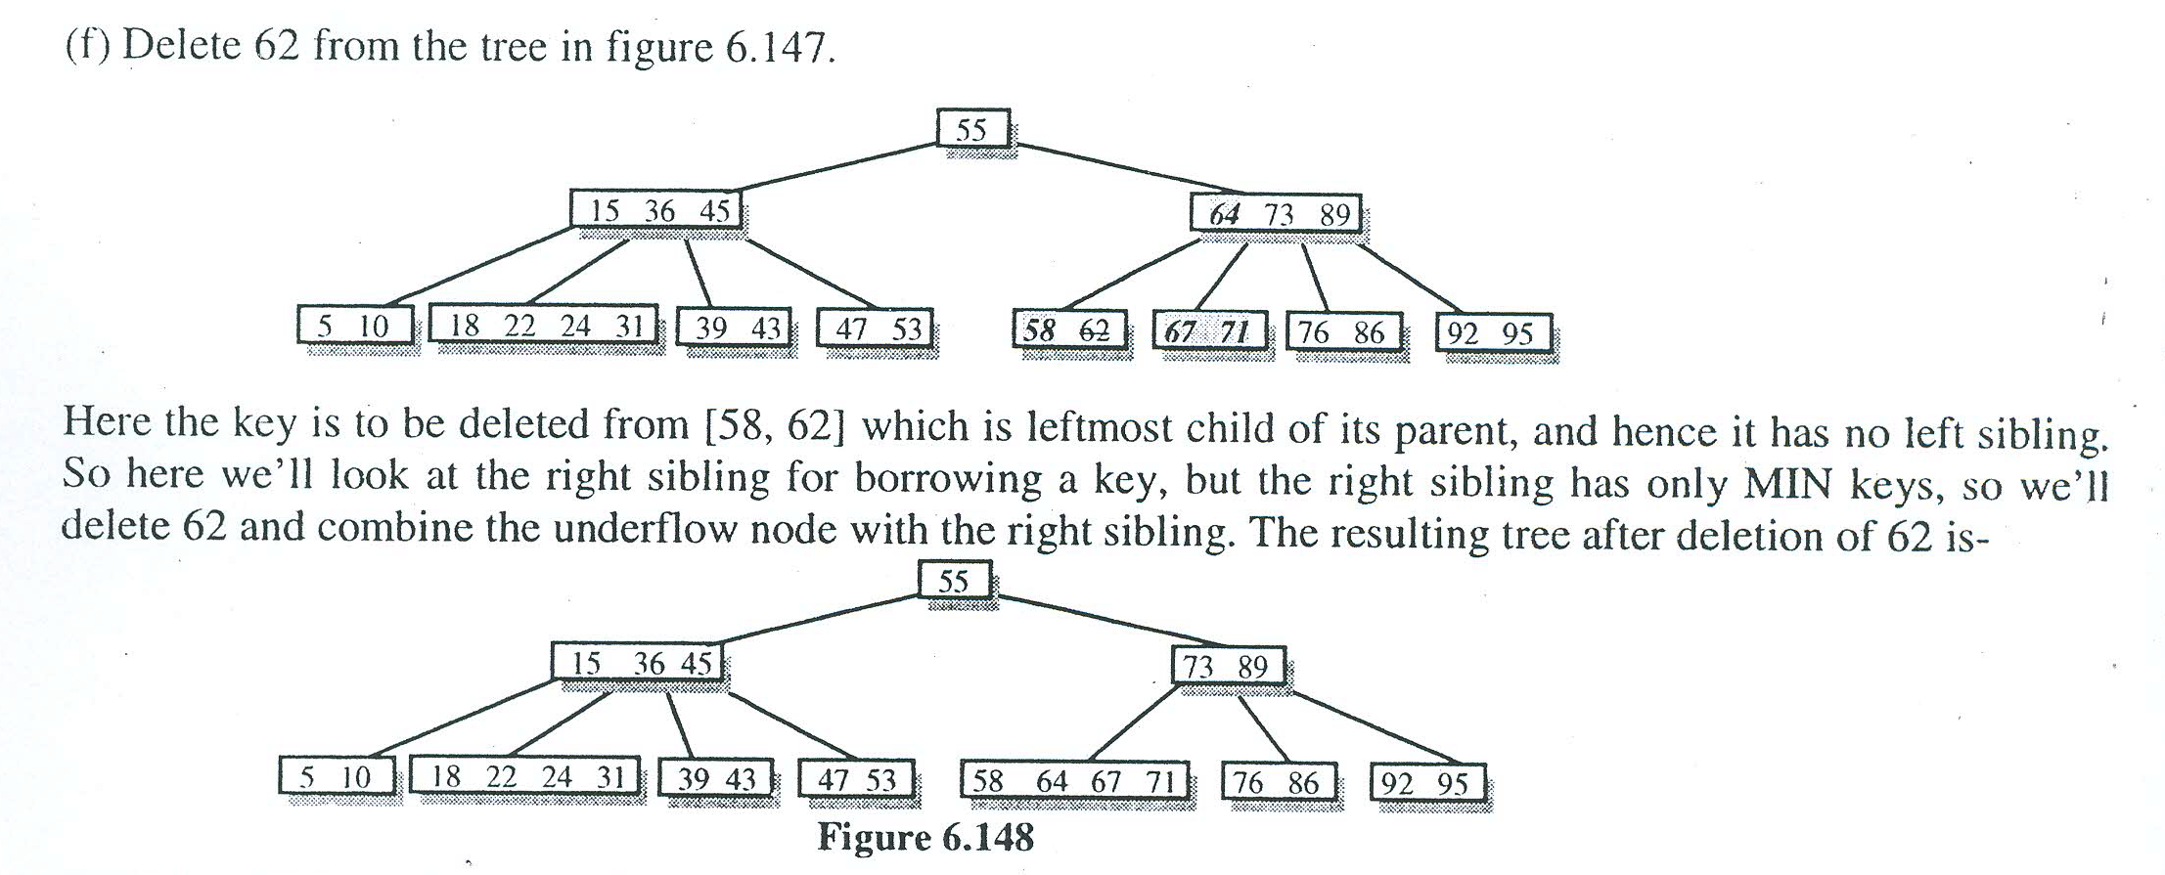

Slide 29
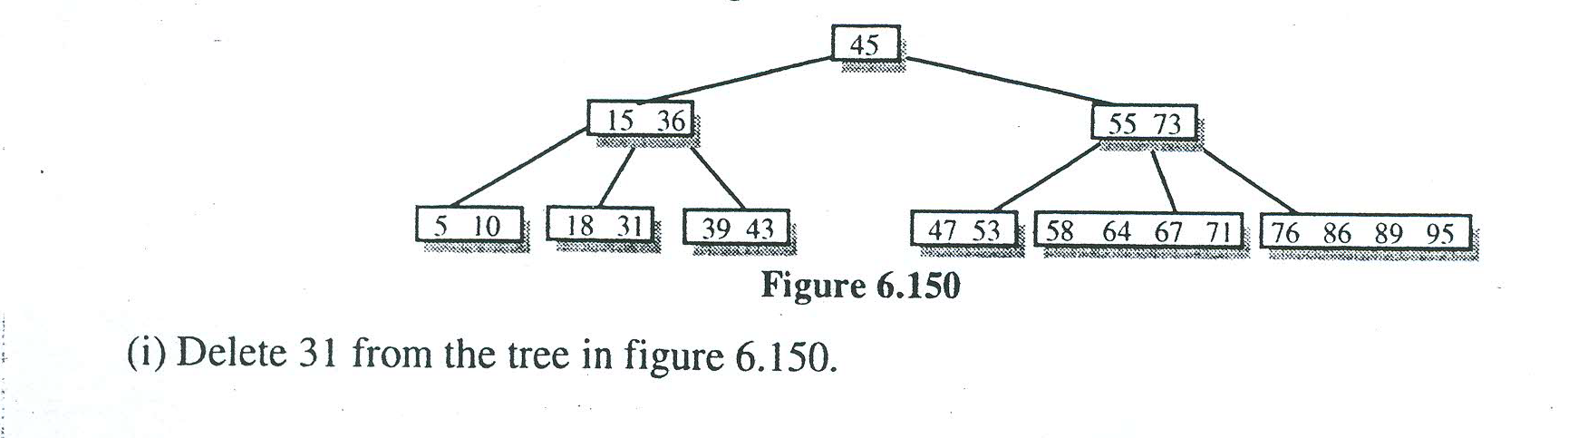

Slide 30
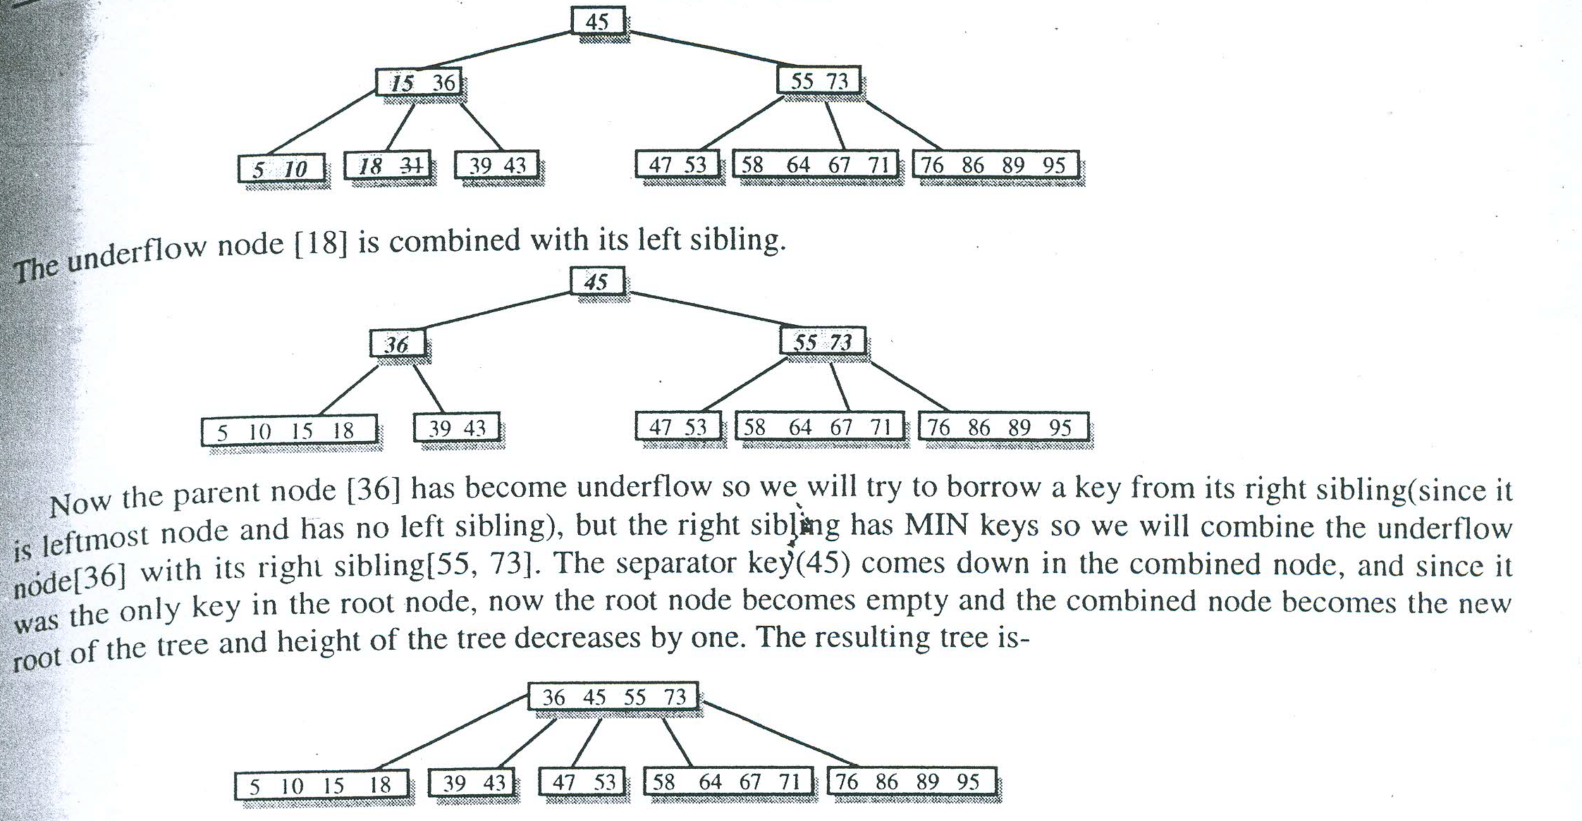

Slide 31
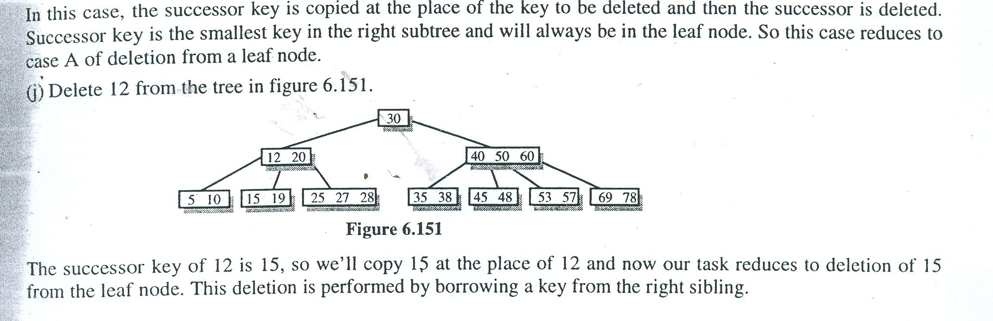
Deletion from Non leaf node

Slide 32
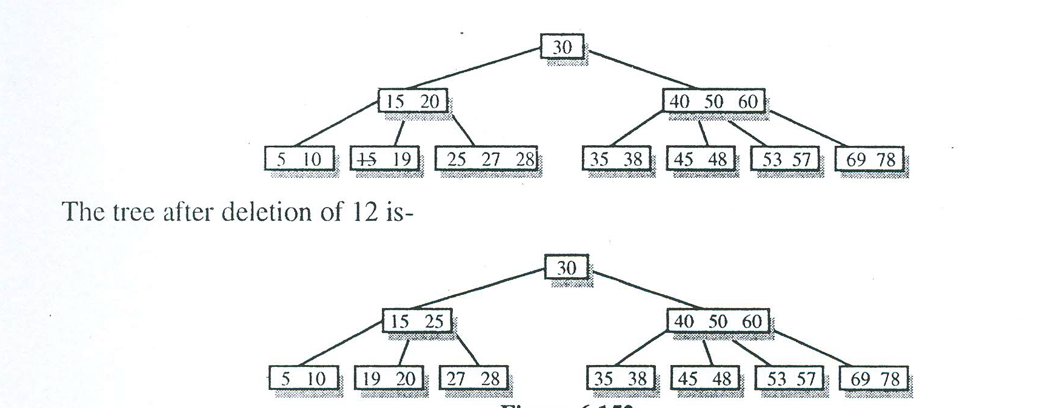

Slide 33
